Slide 1
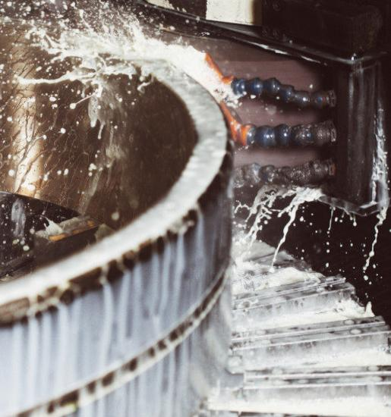
CIP cleaning System in dairy industry
Name : Meghavi Patel
12202200601004

Slide 2
Clean in Place(CIP) Process
CIP is an automated method of cleaning the interior surfaces of pipes, tanks, lines, heat exchangers, process equipment, and associated fittings without requiring the operator to disassemble the equipment.It is most commonly used by dairy and beverage industries to maintain hygenic level.

Slide 3
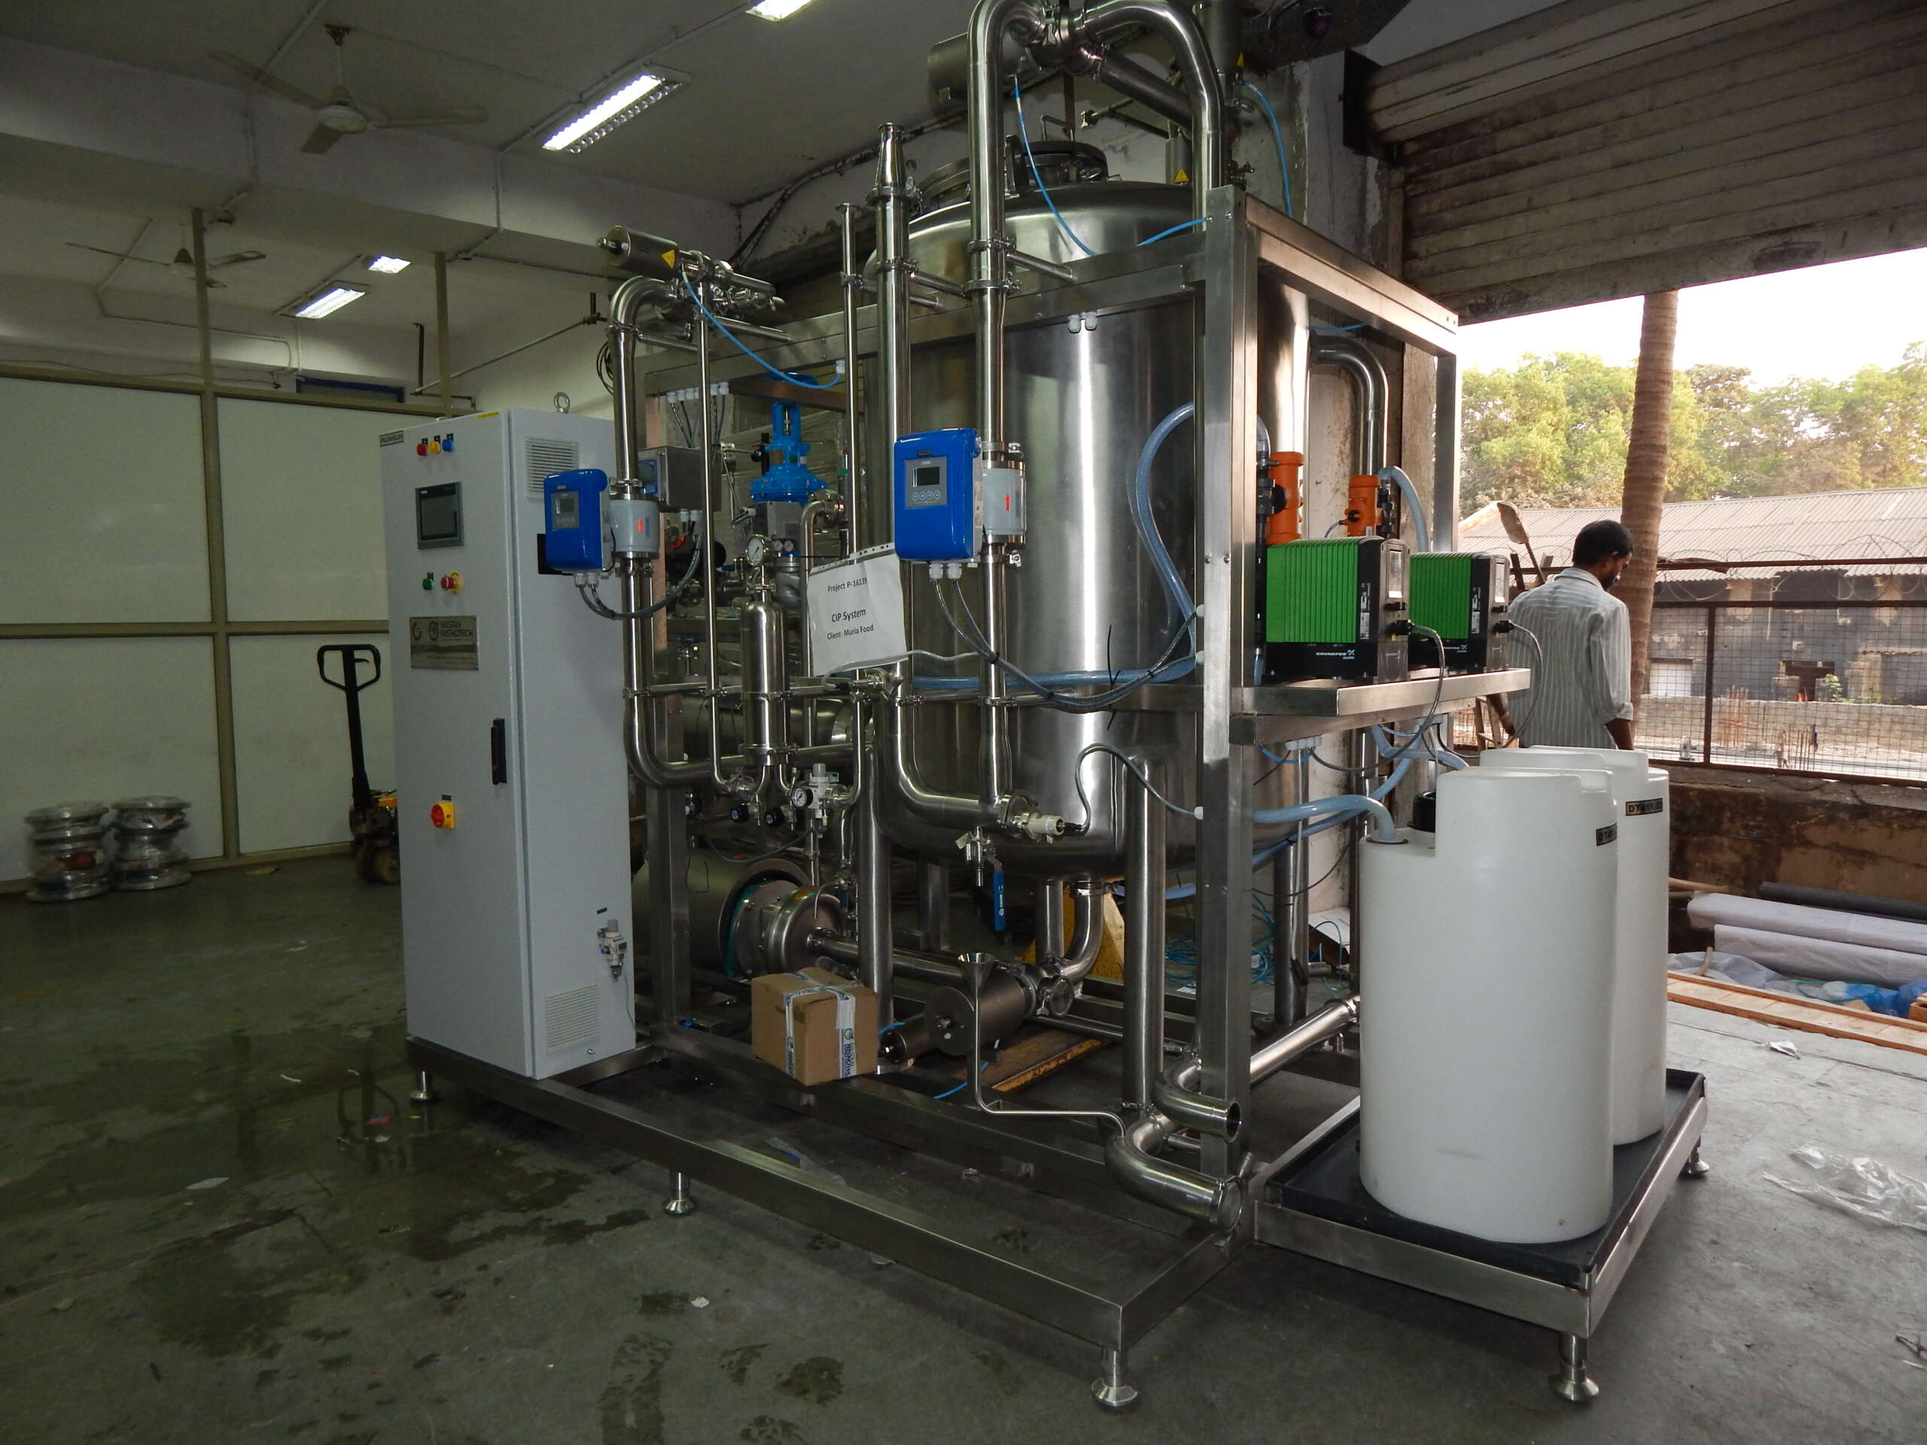
Working Principle
First we put the sufficient amount of detergent in the interiors of a CIP system. The detergent used for cleaning is usually the Mixture of Caustic soda, nitric acid and phosphoric, Sodium Hypochlorite (Hypo), and Peracetic Acid (PAA). After this we apply sufficient heat and pressure of water to remove dirt or other dust particles from the interiors.

Slide 4
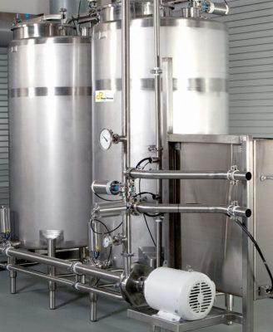
Types of CIP Systems on the basis of Applications
1. Distributed System 2.Central System

Slide 5
Distributed System
Individual sections of the plant can be cleaned with a local dedicated unit. Necessary for the operation that requires specific chemicals e.g. Membrane processing systems.

Slide 6
Central System
Highly Automated to avoid downtime Normally used in Production companies with limited risk of damage through contamination

Slide 7
Basic components of a Clean In place System
Supply Tanks Sensors and Associated valves Supply pump Modular Pressure Transmitter Shell tube heat exchanger Cleaning equipment Instrumentation and automated controls

Slide 8
Fields of Applications
Cip systems are commonly used in manufacturing processes in the FB, Brewing, Pharmaceuticals and geothermal industries for the cleaning of Vessels Bioreactors Fermenters Piplines Conveyor Systems Meat Slicers

Slide 9
Chemicals Used in Cleaning Process
Caustic Detergents Acid Detergents Sanitizer Sequ-es-trants Surfactants

Slide 10
Benefits of a CIP System
Increase in Productivity As cleaning is automatic so there will be a less human effort in cleaning. We can use that time and manpower in increasing productivity. Minimize Errors As we know whole cleaning process is automatic which in turn reduces the chance of human errors. As a result chances of manufacturing an unsafe product will be reduced. Enhance Safety All chemicals and cleaning agents are contained in the vessels which reduces the exposure of harmful chemicals to workers.

Slide 11
Thank you!!!

